Slide 1
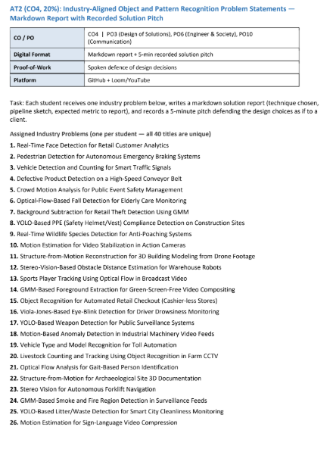

Slide 2
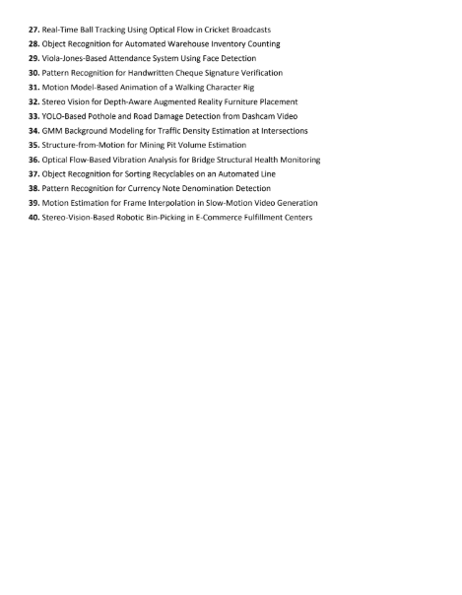

Slide 3


SIMATS ENGINEERING
SAVEETHA INSTITUTE OF MEDICAL AND TECHNICAL SCIENCES
GMM Background Modelling for Traffic Density Estimation at Intersections
DSA0205- Computer Vision with Open CV
Abdul Razak Shaik (192524358)

Slide 4
ABSTRACT
Gaussian Mixture Model (GMM) is used to separate moving vehicles from the static background in traffic surveillance videos.
The system first captures video frames from an intersection camera and performs basic preprocessing.
GMM models the background using multiple Gaussian distributions, allowing it to handle changes in lighting, shadows, and small background movements.
Moving vehicles are identified as foreground objects by comparing each frame with the learned background model.
Detected vehicles are counted and analyzed to estimate the traffic density at the intersection.
The estimated density can be used to identify low, medium, and high traffic conditions.
This approach provides an efficient computer vision solution for real-time traffic monitoring and intelligent traffic management.

Slide 5
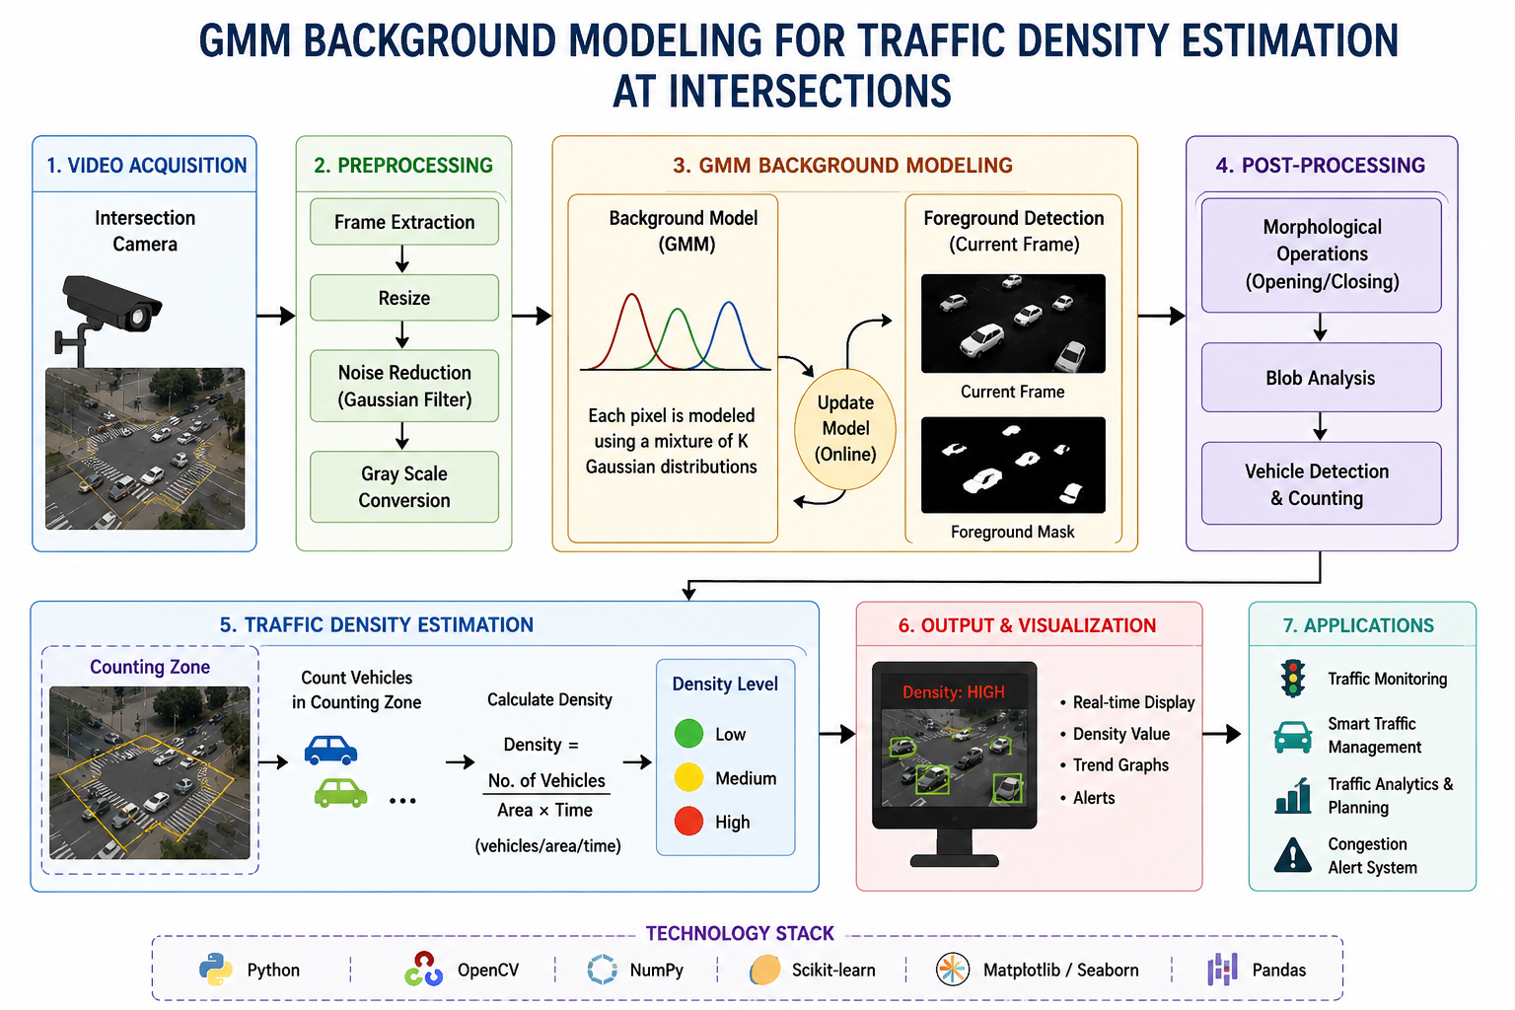

Slide 6
THANK YOU

